Slide 1
.Net MAUI app using C# Markup
https://learn.microsoft.com/en-us/windows/apps/windows-dotnet-maui/tutorial-csharp-ui-maui-toolkit

Slide 2
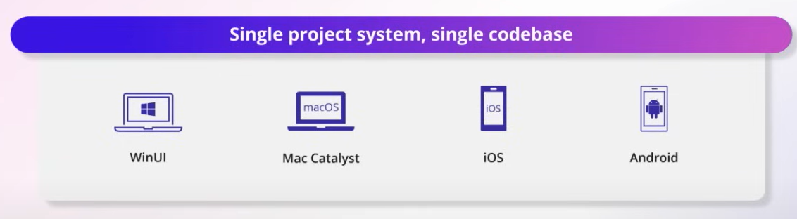
What is MAUI?
Cross-platform framework to develop apps for Windows, Android, iOS, macOS from a single shared code-base
https://dotnet.microsoft.com/en-us/apps/maui

Slide 3
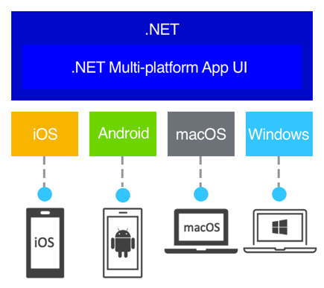
High-level view of the architecture

Slide 4
Written on Windows / Mac, compiled to native
Android: C# -> intermediate language (IL). When launch, just-in-time (JIT) compiled to a native assembly
iOS: fully ahead-of-time (AOT) compiled to native ARM assembly code
macOS: use Mac Catalyst, built with UIKit to the desktop, and augments with additional AppKit and platform APIs as required
Windows: use Windows UI 3 (WinUI 3) library to create native apps that target the Windows desktop

Slide 5
What is C# Markup?
One of the features of .NET MAUI Community Toolkit
Extensions
Behaviors
Animations
Other helpers
The ability to create a user interface entirely in C# code

Slide 6
Why should we use C# markup instead of XAML?
MVU style of React switch (Elm)
iOS: SwiftUI
Android: Jetpack Compose
Quick learning curve for C# developers

Slide 7
C# markup Quick start guide

Slide 8
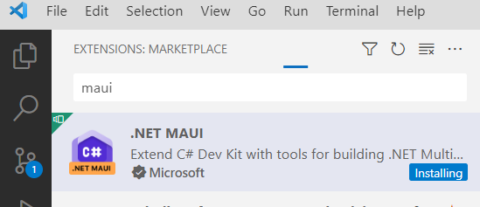
Setting up the environment
Visual Studio Code
Install extension: .Net Maui
dotnet workload install maui

Slide 9
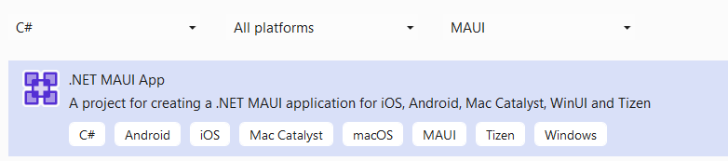
Create a new project
Visual Studio
Visual Studio Code
Ctrl + Shift + P > New Project > .Net Maui App Mobile Desktop
Choose folder > Choose the name of the project

Slide 10
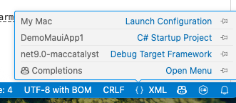
Select config

Slide 11
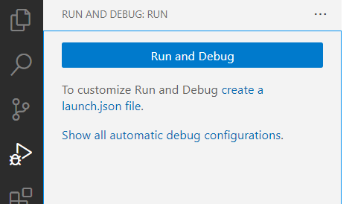
VS Code: Create a launch.json file to build and run
Open file csproj
Click on Create a launch.json file

Slide 12
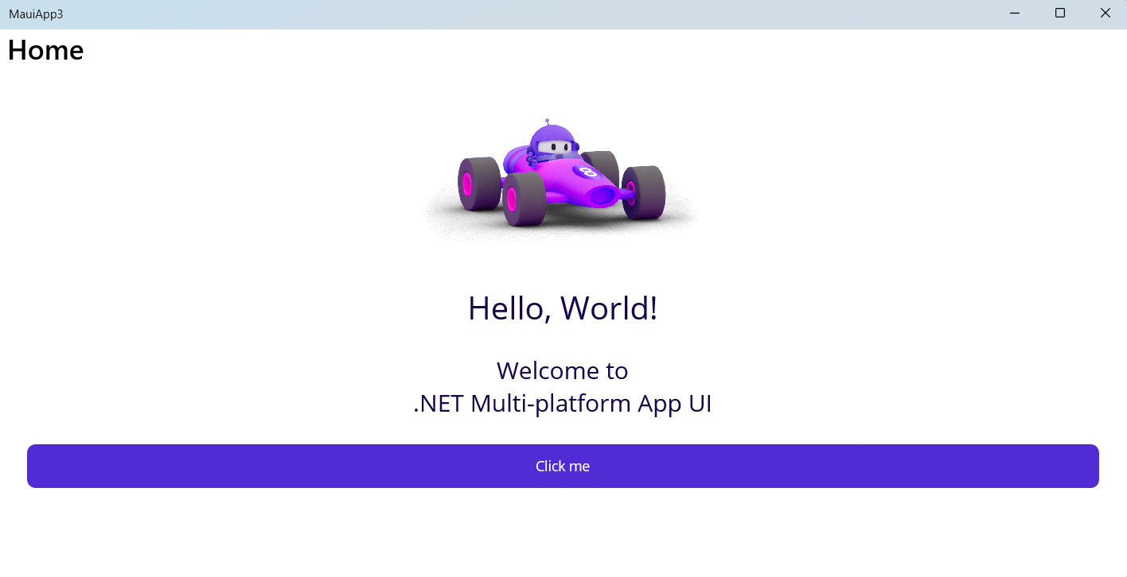
Sample result on Windows

Slide 13
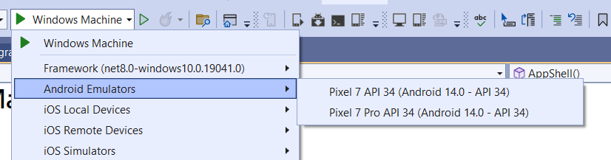
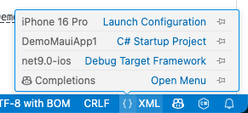
Switch to another platform - Visual Studio

Slide 14
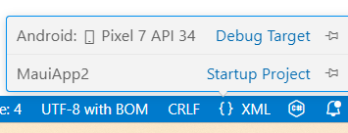
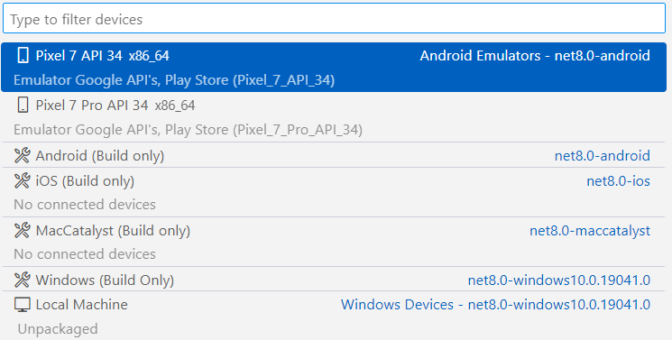
Switch to another platform - Visual Studio Code
Click on the {} button on the bottom right corner

Slide 15
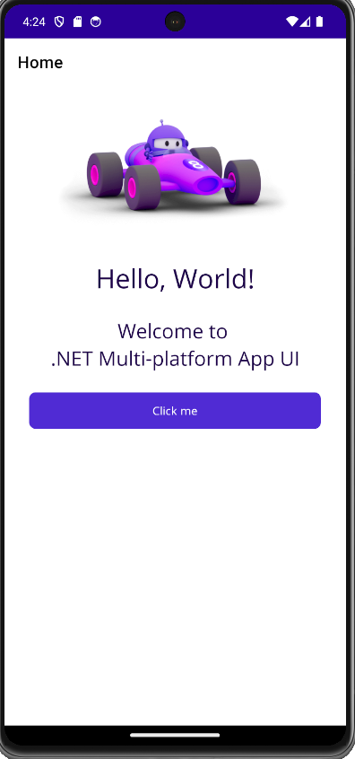
Sample result on Android
May need to install Microsoft JDK 17 (not 21)
May need to install Android Platform tool 35
Read the errors and instructions carefully

Slide 16
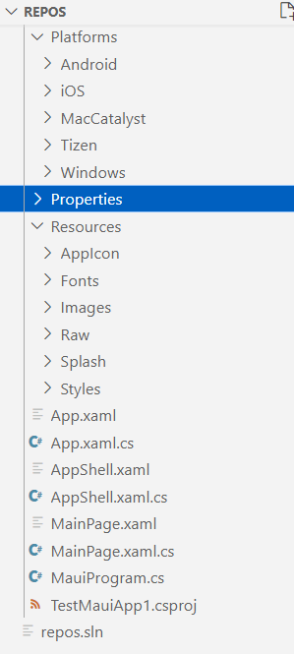
Project structure
Supported platforms
Android
iOS
Mac
Windows

Slide 17
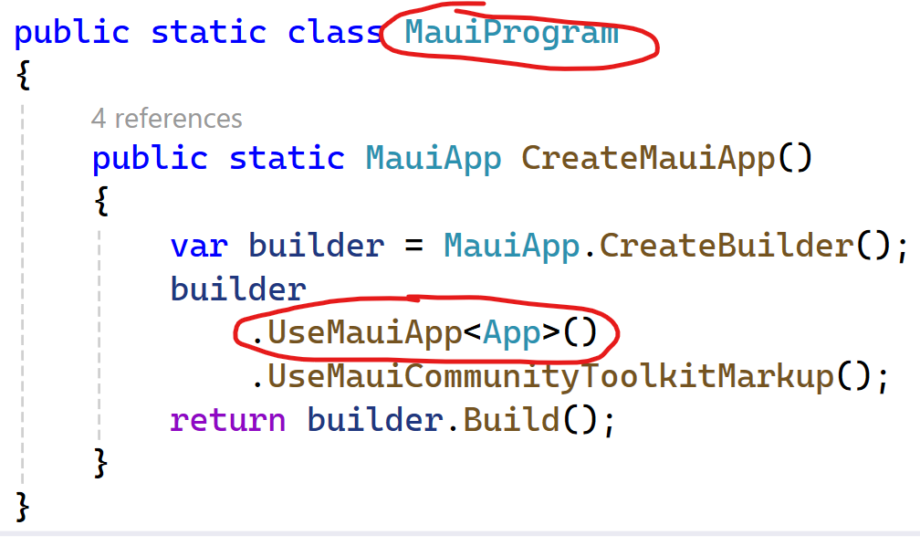
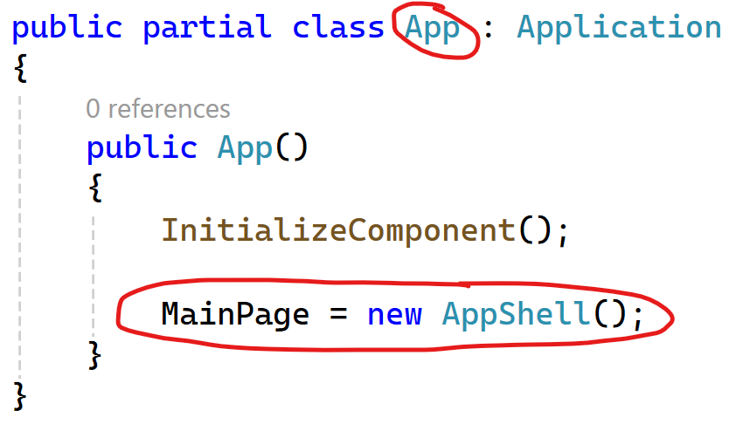
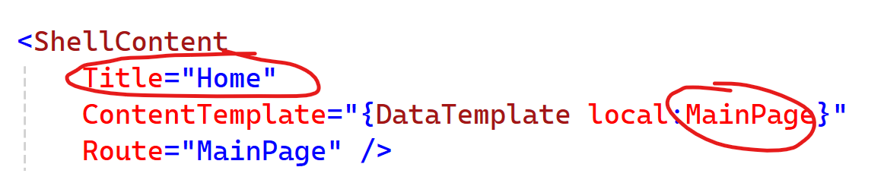
Entry point & flow of execution
MauiProgram.cs
App.xaml.cs
AppShell.xaml

Slide 18
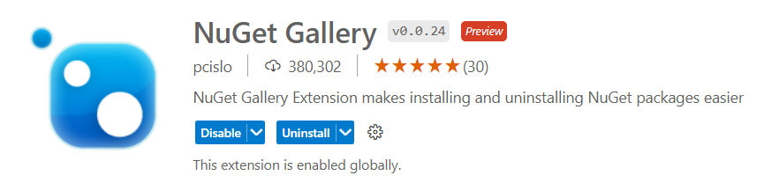
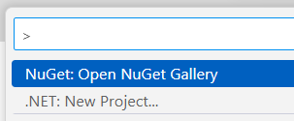
VSCode: Install Nuget Gallery extension
Ctrl + Shift + P > NuGet: Open NuGet Gallery

Slide 19
Add C# Markup using Community Toolkit
CommunityToolkit.Maui.Markup
dotnet add package CommunityToolkit.Maui.Markup

Slide 20
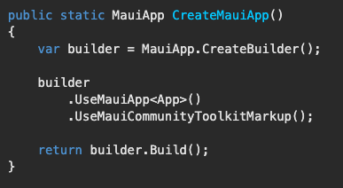
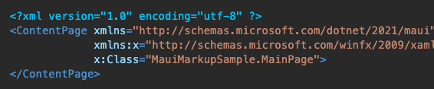


Build a UI with C# Markup
MauiProgram.cs
MainPage.xaml: Delete the file content
MainPage.xaml.cs
using CommunityToolkit.Maui.Markup;

Slide 21
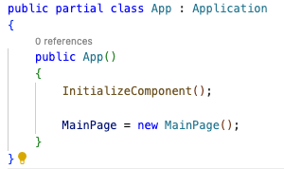
Removing the AppShell (for simplicity)
Delete two files: (We will talk about Shell later)
AppShell.xaml
AppShell.xaml.cs
Modify App.xaml.cs to display our MainPage

Slide 22
Artifacts

Slide 23
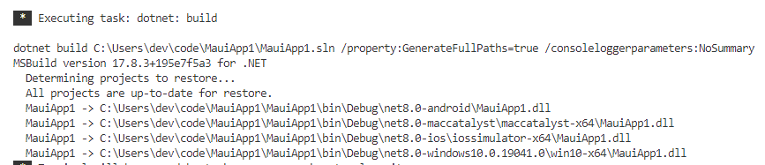
Perform a build only
Ctrl + Shift + P > .Net Build

Slide 24
Debug

Slide 25
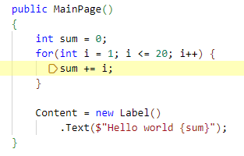

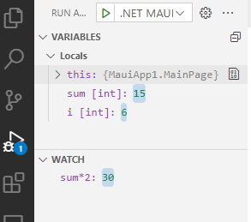
Modify MainPage.xaml.cs & set breakpoint
Continue: F5
Step over: F10
Step into: F11
Step out: Shift+F11

Slide 26
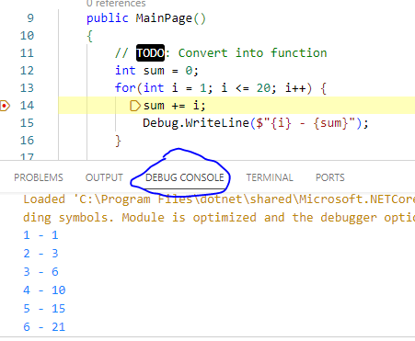
Adding debug info into console

Slide 27
TODO

Slide 28
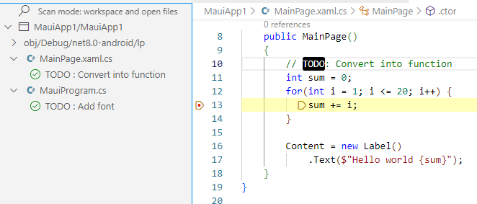
Install TODO Tree Extension

Slide 29
View code behind extension
To switch between code & markup file

Slide 30
App icon & Splash screen
https://learn.microsoft.com/en-us/dotnet/maui/user-interface/images/app-icons

Slide 31
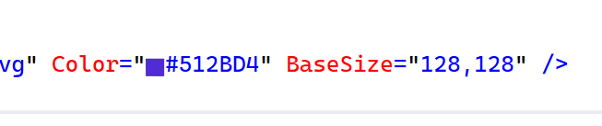
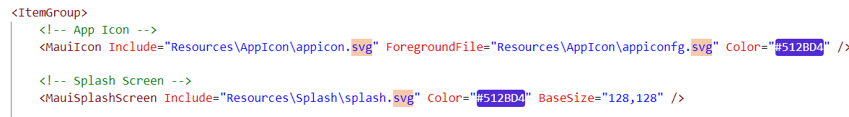
Add color highlight
Visual Studio: Right Click > Edit project file
(Install Inline Color Picker extension)
Visual Studio Code: Open .csproj file
(Install Color highlight extension)

Slide 32
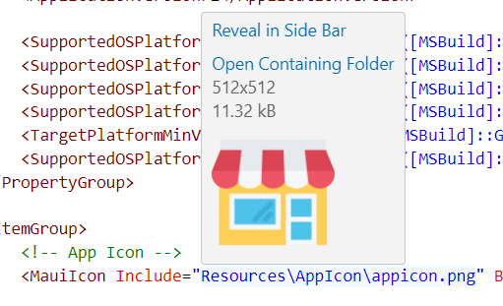
Replace appicon.svg with your image (keep the name)
(Install extension Image Preview for hover effect)

Slide 33
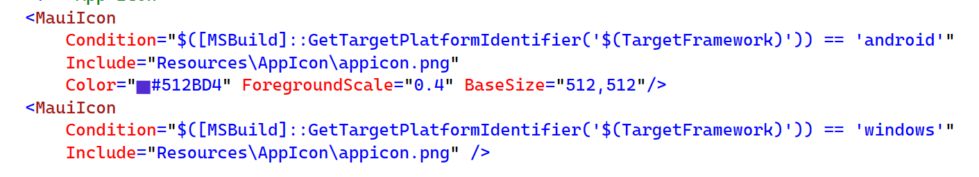
Conditional for Android
Notes:
<MauiIcon
Condition="$([MSBuild]::GetTargetPlatformIdentifier('$(TargetFramework)')) == 'android'"
Include="Resources\AppIcon\appicon.png"
Color="#512BD4" ForegroundScale="0.4" BaseSize="512,512"/>
<MauiIcon
Condition="$([MSBuild]::GetTargetPlatformIdentifier('$(TargetFramework)')) == 'windows'"
Include="Resources\AppIcon\appicon.png" />

Slide 34
Hot reload

Slide 35

Usage
Make change in the source code
Click on Hot reload button to see changes immediately
Only on Windows with Visual Studio not VS Code

Slide 36
On by default in pre-release version
Check maui.markup samples
https://github.com/CommunityToolkit/Maui.Markup
- C# Hot Reload with Android and WinUI should work, but iOS/Catalyst aren't yet supported.

Slide 37
Architecture

Slide 38

Enterprise Application Patterns Using .NET MAUI
https://docs.microsoft.com/dotnet/architecture/maui/

Slide 39
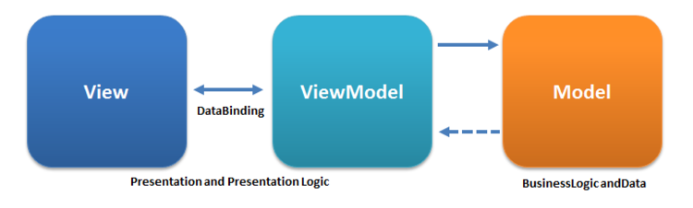
MVVM Tutorial
https://www.tutorialspoint.com/mvvm/index.htm

Slide 40
Learn from sample code

Slide 41
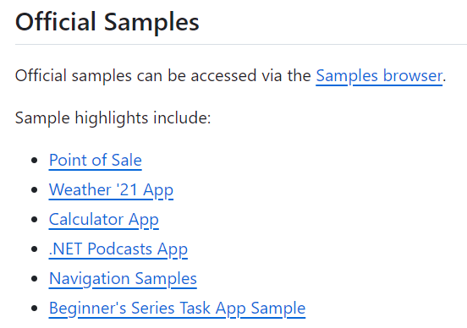
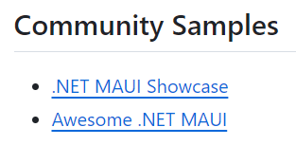
https://github.com/dotnet/maui-samples

Slide 42
Clone this sample repo
$git clone https://github.com/dotnet/maui-samples.git
Open folder 9.0
Investigate sample source codes

Slide 43
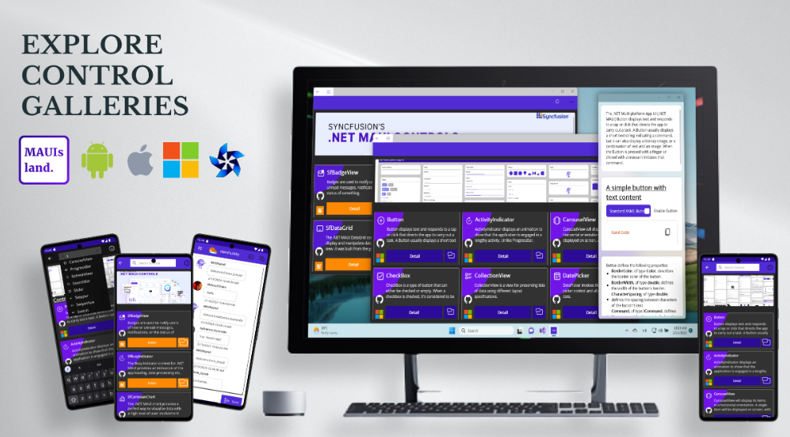
2. Maui showcase - Good looking samples
$ git clone https://github.com/jsuarezruiz/dotnet-maui-showcase.git

Slide 44
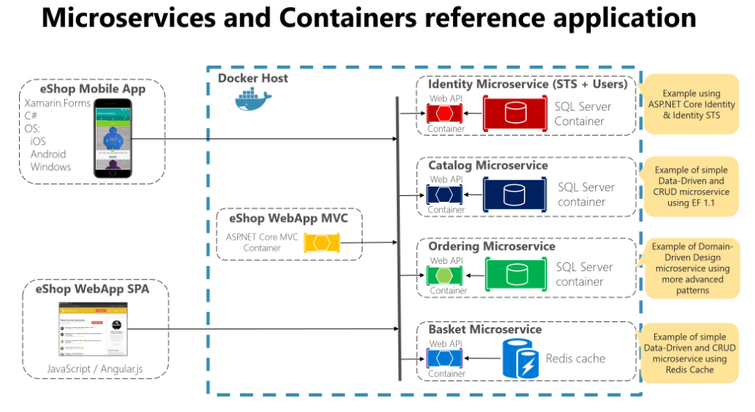
3. eShop mobile client
$ git clone https://github.com/dotnet-architecture/eshop-mobile-client.git

Slide 45
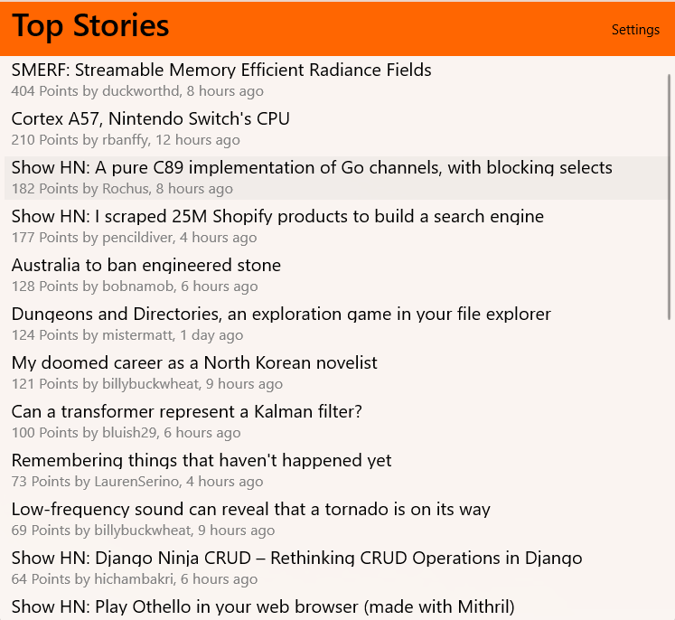
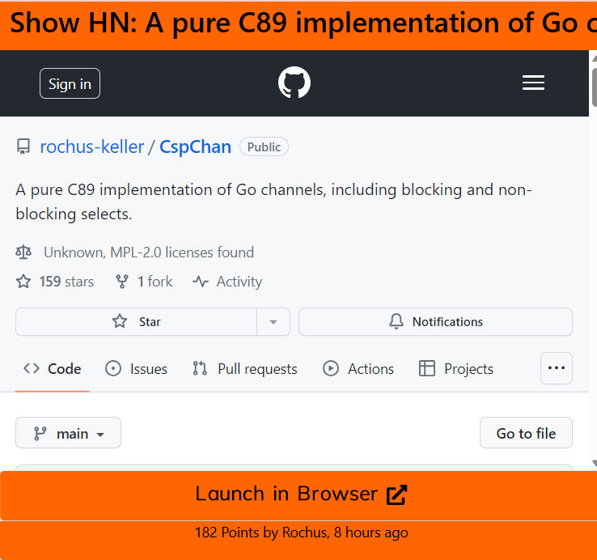
4. Markup community toolkit samples
$ git clone https://github.com/CommunityToolkit/Maui.Markup.git

Slide 46
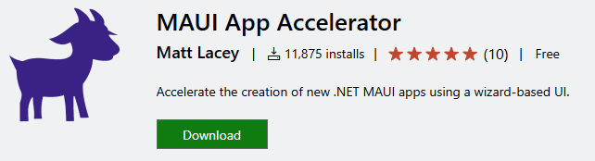
5. Template for project - MAUI App Accelerator

Slide 47
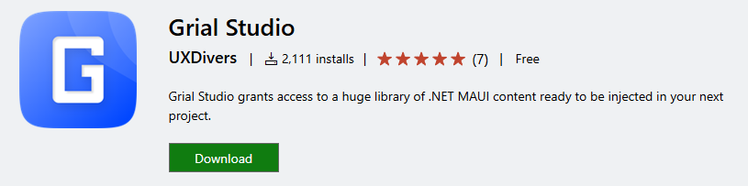
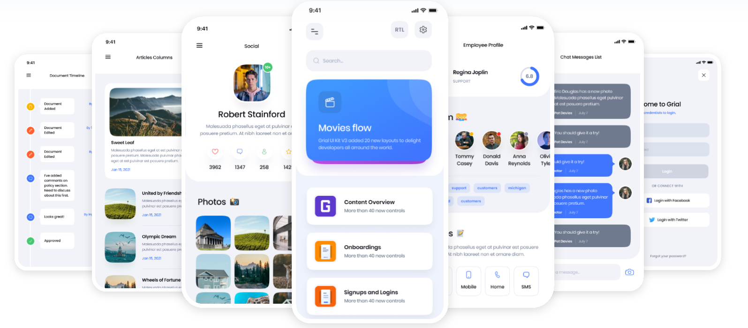
6. Inspired by commercial sample app - Grial Studio

Slide 48
Getting started
https://learn.microsoft.com/en-us/windows/apps/windows-dotnet-maui/tutorial-csharp-ui-maui-toolkit

